Slide 1

Metal Forming – BSc 2026/27-1
Formability

Slide 2
Topics
Concept of formability
Formability of materials:
  Bulk forming
  Sheet forming
Measurement techniques

Slide 3
Formability is a mechanical property of a material.
It is characterised by a deformation limit.
As a mechanical property, it is influenced by the so-called state parameters:
    – the state of stress
    – the strain rate
    – the temperature.

Slide 4
Concept of formability
The plastic deformation is limited by:
– plastic instability
– crack and fracture
Unstable plastic deformation:
At a certain point in the material, the effect of hardening is abrogated by softening.
The source of softening can be:
    – change of geometry,
    – change of the strain rate
    – change of temperature.

Slide 5
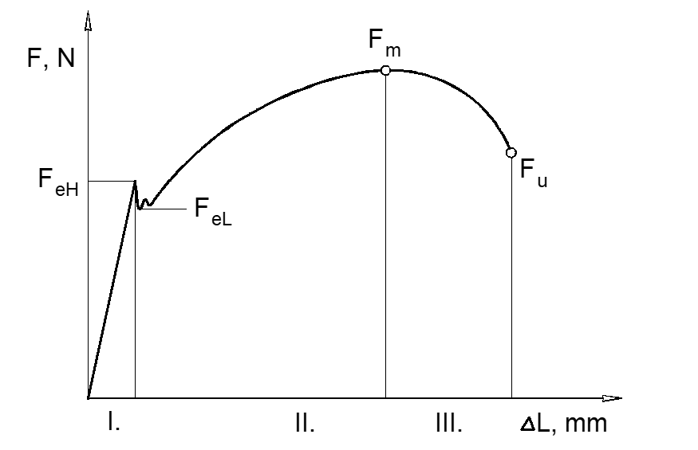
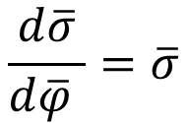

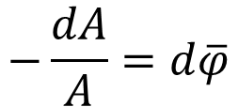


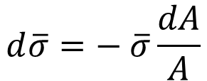
Plastic instability
The plastic deformation is stable in a cylindrical tensile testing specimen if the force increases with increasing deformation:
$$dF>0$$
Plastic instability occurs when:
$$dF=0$$
Force at this case:
$$F=\overline{σ}A$$
Limit of stability:
$$dF=d\left(\overline{σ}A\right)=d\overline{σ}A+\overline{σ}dA=0$$
$$d\overline{σ}=− \overline{σ}\frac{dA}{A}$$
$$−\frac{dA}{A}=d\overline{φ}$$
where
$$\frac{d\overline{σ}}{d\overline{φ} }=\overline{σ}$$
⇒
Next slide

Slide 6

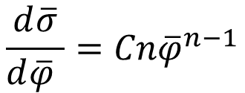


Plastic instability
⇒
$$\frac{d\overline{σ}}{d\overline{φ} }=Cn{\overline{φ}}^{n−1}$$
Assuming that:
$$\overline{σ}=σ_{flow}=C{\overline{φ}}^{n}$$
Limit of stability:
$$Cn{\overline{φ}}^{n−1}=C{\overline{φ}}^{n}$$
⇒
$${\overline{φ}}_{critical}=n$$
Plastic instability occurs when the critical strain is reached; it leads to local plastic deformation (contraction), then fracture of the sample.
Plastic instability can occur during the forming of car body parts, leading to local sheet thinning.
It is beneficial if the value of n is higher.

Slide 7
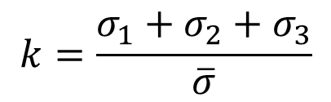
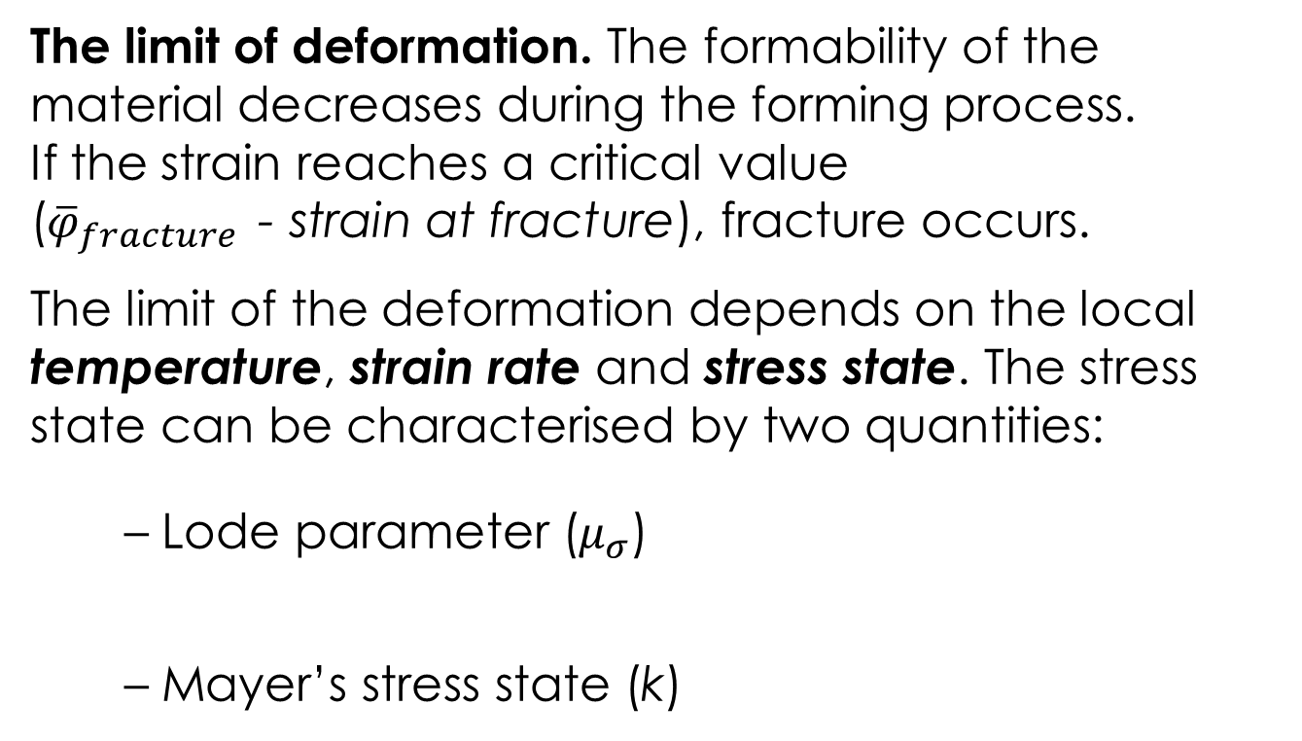
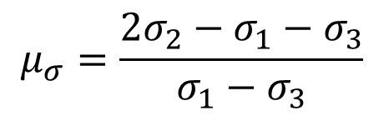
Plastic strain to fracture
The limit of deformation. The formability of the material decreases during the forming process.
If the strain reaches a critical value
(${\overline{φ}}_{fracture}$- strain at fracture), fracture occurs.
The limit of the deformation depends on the local temperature, strain rate and stress state. The stress state can be characterised by two quantities:
– Lode parameter ($μ_{σ}$)
– Mayer’s stress state (k)
$$μ_{σ}=\frac{{2σ}_{2}−σ_{1}−σ_{3}}{σ_{1}−σ_{3}}$$
$$k=\frac{σ_{1}+σ_{2}+σ_{3}}{\overline{σ}}$$

Slide 8
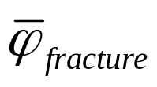
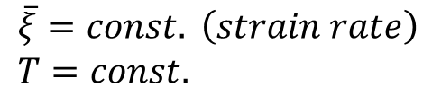
Forming limit diagram for bulk techniques
$$\overline{ξ}=const. \left(strain rate\right) \\ T=const.$$
Plastic strain at fracture
µ_{σ}= -1
µ_{σ}= 0
-
Mayer’s stress state k
+

Slide 9
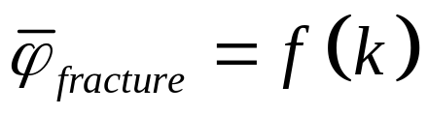
Formability diagram
The occurrence of a fracture can be analyzed by the forming limit diagrams (FLD):
The forming limit diagram of bulk forming processes can be determined by conducting experiments causing different stress states (tensile, upsetting, torsion, bending etc. tests).
The increasing temperature shifts the curves upwards.
The increasing strain rate shifts the curves downwards.

Slide 10
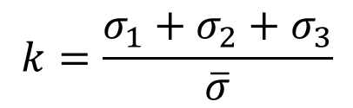
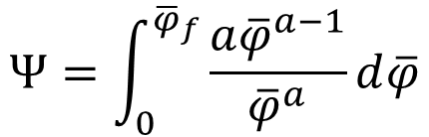


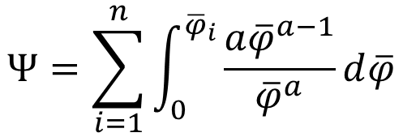


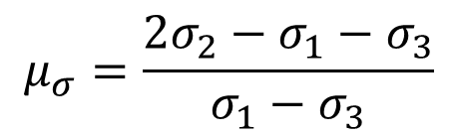
Bogatov fracture theory
For calculations a fracture theory is needed – Bogatov theory
For continuous forming
For multistep forming
$$Ψ=\int_{0}^{{\overline{φ}}_{f}}{\frac{a{\overline{φ}}^{a−1}}{{\overline{φ}}^{a}}d\overline{φ}}$$
$$Ψ=\sum_{i=1}^{n}{\int_{0}^{{\overline{φ}}_{i}}{\frac{a{\overline{φ}}^{a−1}}{{\overline{φ}}^{a}}d\overline{φ}}}$$
$${\overline{φ}}_{critical}=f(k,μ_{σ},\overline{ξ},T,{\overline{x}}_{i})$$
$$a=a(k,μ_{σ},\overline{ξ},T,{\overline{x}}_{i})$$
$Ψ=1$ ⇒ fracture
Mayer’s stress state (k)
Lode parameter ($μ_{σ}$)
$$k=\frac{σ_{1}+σ_{2}+σ_{3}}{\overline{σ}}$$
$$μ_{σ}=\frac{{2σ}_{2}−σ_{1}−σ_{3}}{σ_{1}−σ_{3}}$$

Slide 11


Forming limit diagram (FLD)
The formability for sheet metal forming techniques is characterized by the forming limit diagram (FLD) below.
Major strain
Fracture can be expected
Safe zone
+
–
0
+
Minor strain

Slide 12
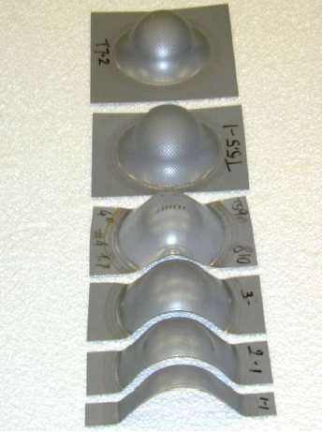
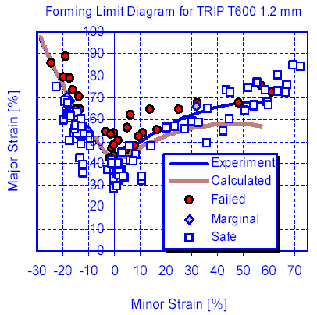
Forming limit diagram (FLD)
Determination of the FLD using Nakazima test

Slide 13
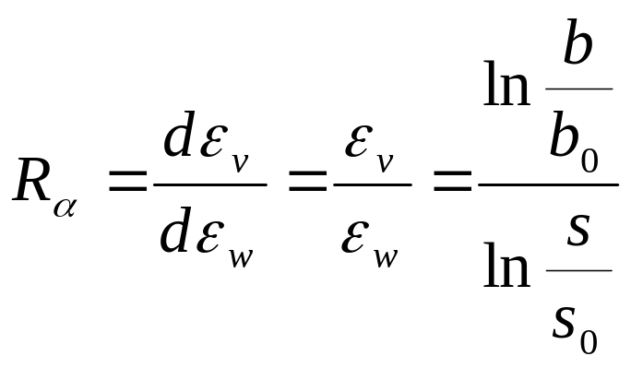
R and n values
Important quantities of sheet formability from tensile test:
– Lankford coefficient (R)
– hardening exponent (n).
The R-value characterises the normal anisotropy (perpendicular to the sheet’s plane) of the sheet.
Cross section of the tensile test specimen
s_{o}
s
b_{o}
b
b_{o} and s_{o} are the original, b and s the deformed dimensions. The α is the angle describing the specimen’s orientation relative to the rolling direction of the sheet (see next slide).

Slide 14
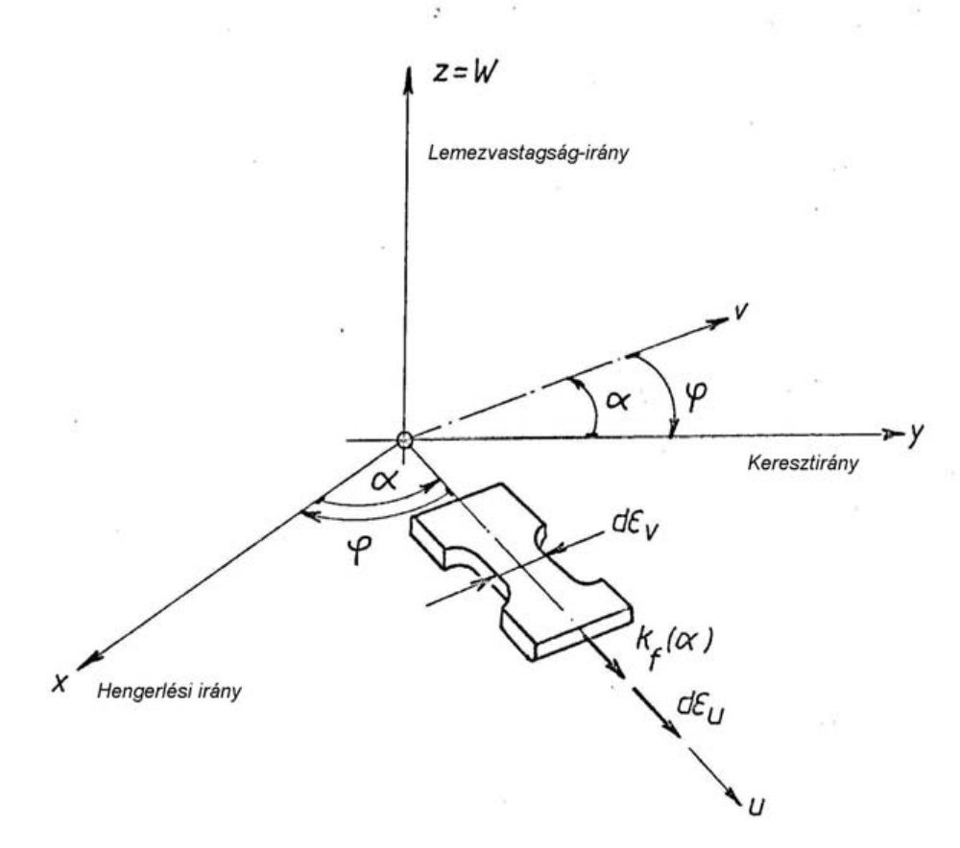
R and n values
The α angle
Sheets are always not isotrop!
Normal
direction
Transverse
direction
Rolling
direction

Slide 15
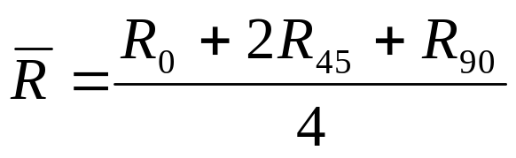
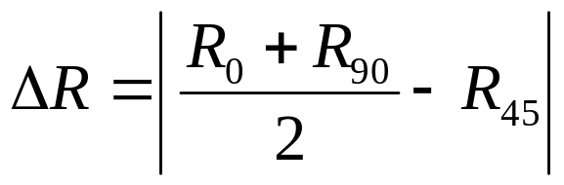
R and n values
The Lankford coefficient is the weighted average of the R_{α} values measured in the directions 0°, 45° and 90° :
From the R_{α} values the planar anisotropy of the sheet also can be calculated:
(normal anisotropy)
(planar anisotropy)

Slide 16
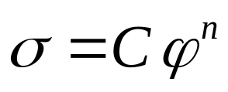
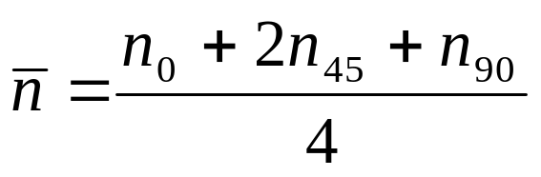
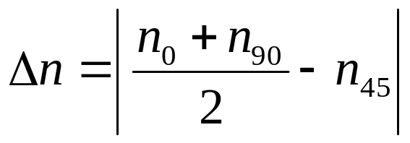
R and n values
The hardening exponent is the exponent of the flow curve which is also direction dependent:
The weighted average of the n values measured in the directions 0, 45 and 90° :
From the n_{α} values the planar anisotropy of the hardening can also be calculated:

Slide 17
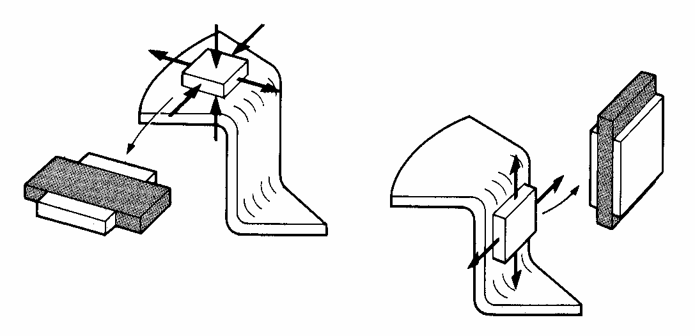
Connection of R and n values to deep drawing
Example: Stress and strain state during deep drawing
in the cylinder
in the flange
Wish: High normal anisotropy with low planar one

Slide 18
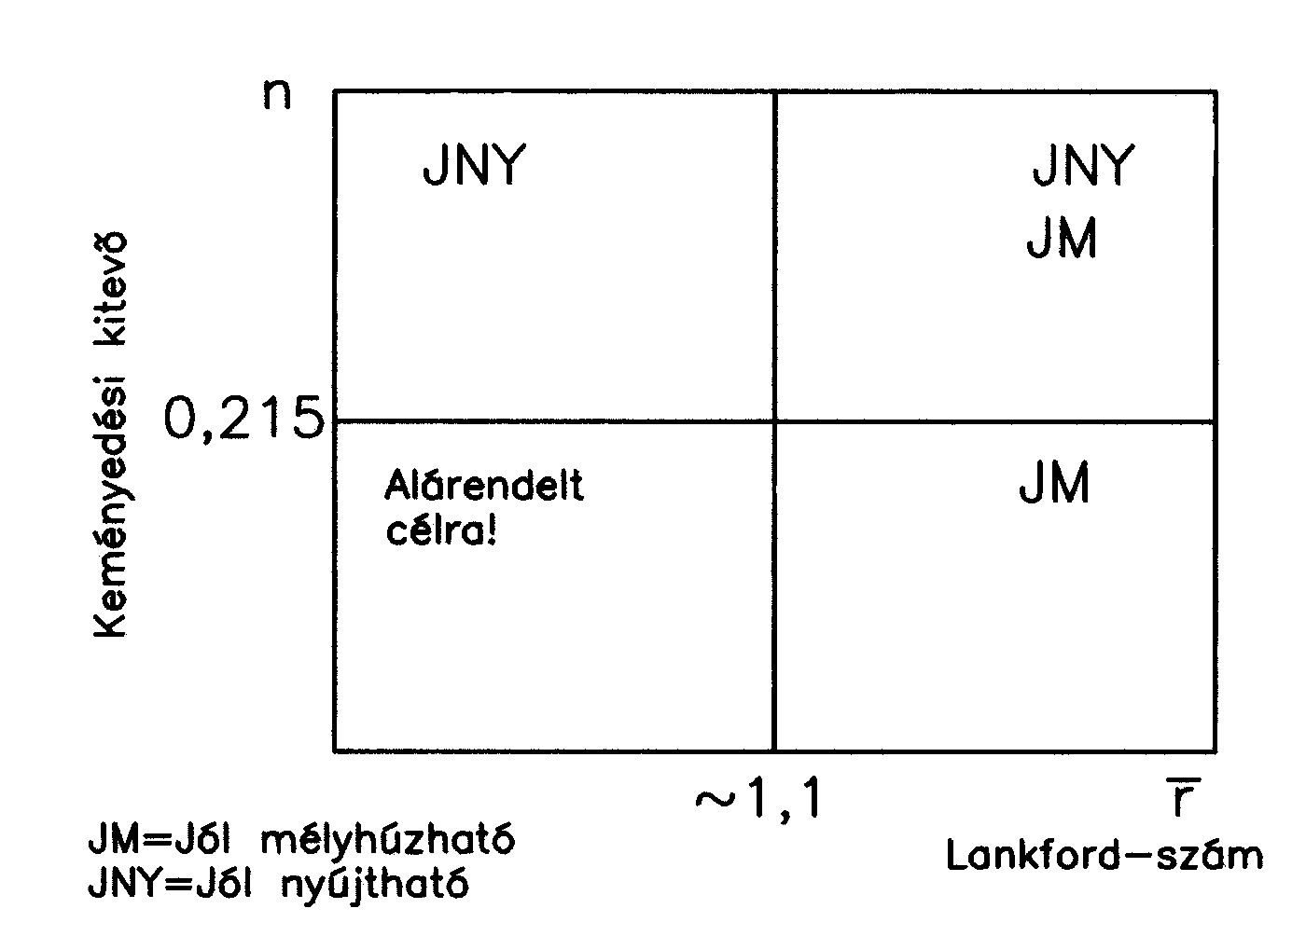
R and n values
Connection of R and n values to sheet forming technologies
Lillet diagram
St
DD
St
Hardening exponent
Not good for forming
Only for simple shapes
DD
DD – good for deep drawing
St – good for stretch forming
Lankford coefficient

Slide 19
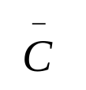
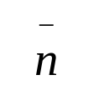
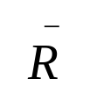



R and n values for some materials
Jel | C N/mm² | n | R
Carbon steel 0º | 554,7 | 0,1714 | 1,817 | 552,8 | 0,164 | 1,59
Carbon steel 45º | 584 | 0,1619 | 1,067
Carbon steel 90º | 488,6 | 0,1454 | 2,41
AlMg3 0º | 461.6 | 0.2914 | 0.613 | 405.4 | 0.2936 | 0.9675
AlMg3 45º | 362.75 | 0.2647 | 1.05
AlMg3 90º | 434.4 | 0.2937 | 1.157

Slide 20
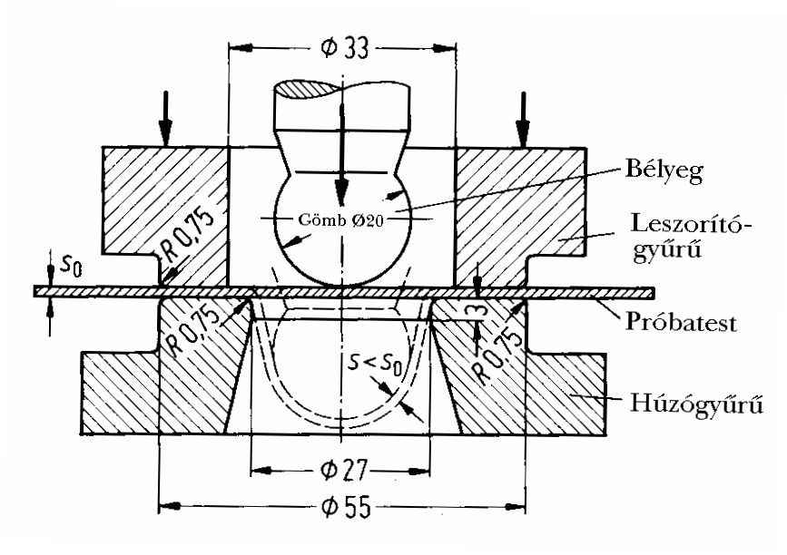
Technological tests - Erichsen test
punch
sphere
sphe
blank holder
specimen
70x70 mm
die
Quantity: displacement of the punch from the contact
till the crack of the specimen (mm)

Slide 21
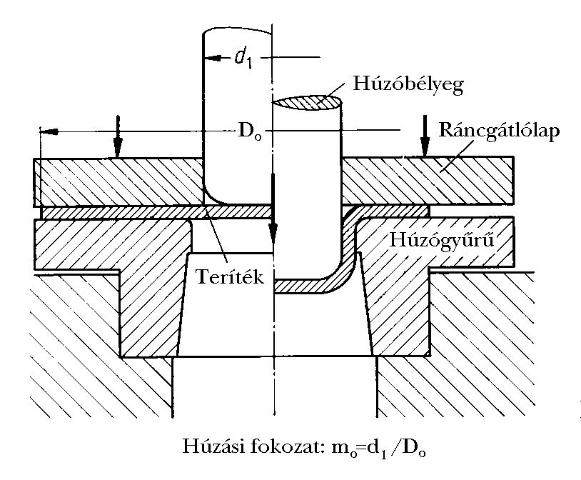
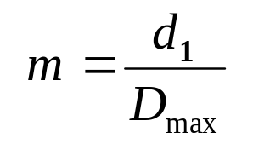
Technological tests – deep drawing of a cup
Cup drawing
33 mm
3 types of punch (flat, rounded, sphere)
blank holder
Quantity:
die
blank
Starting from D_{o} = 58 mm blank diameter, by 2 mm steps
till fracture (up to max. 74 mm).

Slide 22
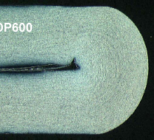
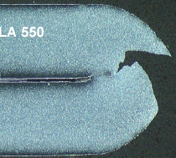
Technological tests – bending
180 degrees
crack
Quantity: bending angle till cracking

Slide 23
Thank you for your attention !

